Slide 1
Linux 시스템 프로그래밍
2018년 2학기
성병문
한세대학교 대학원

Slide 2
교과목 개요
과목명: 고급 프로그램
학점 및 시간 : 3학점(이론 1.5시간, 실습 1.5시간)
강의 목표
리눅스 File I/O 프로그래밍
리눅스 Qt 프로그래밍
리눅스 데이터베이스 프로그래밍
리눅스 네트워 프로그래밍
교재:
제목 : LINUX SYSTEM PROGRAMMING 2nd Ed.
저자/출판사/년도 : Rovert Love / O'REILLY / 2013

Slide 3
강의 내용
순서 | 강의 내용
1 | File I/O 프로그래밍
2 | 리눅스 데이터베이스 프로그래밍
3 | 네트웤 프로토콜 프로그래밍
4 | Network Garbage Data Filtering
5 | SOAP 프로그래밍

Slide 4
실습 환경 구성 1
Linux 운영체제 설치
VmWare workstation 최신판 설치
Ubuntu Desktop LTS 최신판 설치
시스템 업데이트 및 업그레이드
$ sudo apt update
$ sudo apt upgrade
gcc 설치
$ sudo apt install gcc
$ sudo apt install g++
Git 설치
$ sudo apt install git
Visual studio code 편집기 설치
$ sudo snap install vscode --classic

Slide 5
Git Usage
Git Repository Clone
$ git clone https://github.com/sunabove/lec_100_linux.git
Git pull : 서버 내용을 로컬 폴더로 동기화 함.
$ cd lec_100_linux
$ git pull
Git file 초기화 : git pull 에러 발생시
$ git reset --hard HEAD
Git 아이디/암호 저장
$ git config credential.helper store

Slide 6
실습 환경 구성 4
Qt5
https://www.qt.io/
Qt5 설치
sudo apt install qtcreator
sudo apt install qt5-default
sudo apt install qtdeclarative5-dev
Qt5 문서 설치
sudo apt install qt5-doc qt5-doc-html
sudo apt install qtbase5-doc-html qtbase5-examples

Slide 7
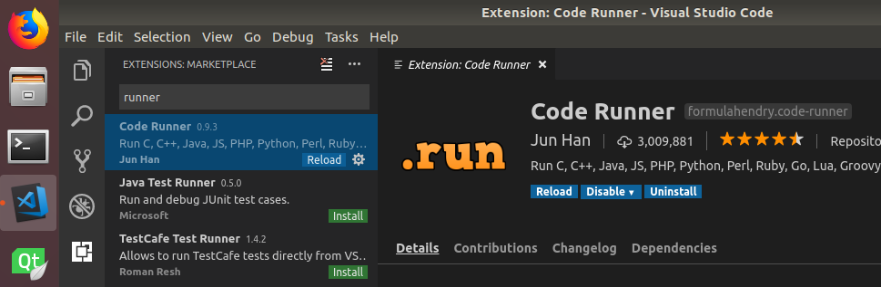
실습 환경 구성 2
Visual Source Code Extension 설치
Code Runner Extension 설치

Slide 8
실습 환경 구성 3
Visaul Studio Code User Setting
File -> Preferences -> Settings
User Setting
{
"code-runner.executorMap": {
"c": "cd $dir && gcc $fileName -o a.out && $dir/a.out" ,
} ,
"files.exclude": {
".vscode": true,
".vimrc" : true,
".gitignore": true,
"**/*.o" : true,
"**/*.out" : true,
} ,
"code-runner.runInTerminal": true ,
}

Slide 9
GIT sequence diagram
Local Repo
Remote Repo
clone (복사/한번만)
add (변경 파일 등록)
commit (변경 파일 기록)
branch (가지 치기)
merge (가지 병합)
push (변경 파일 보내기)
pull (변경 파일 가져오기)

Slide 10
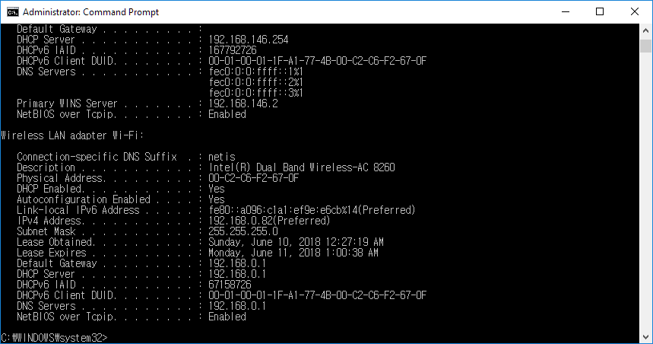
PC Windows 10 네트웍 환경 확인
cmd 창 실행
ipconfig /all
ip 주소가 192.168.0.xxx 임을 확인한다.
무선 네트웍 어댑터 장치명 .
IP 주소 확인 .

Slide 11
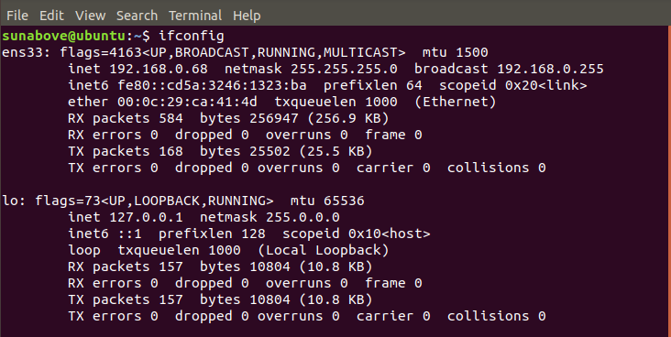
Linux 네트웍 환경 확인
터미널 실행
sudo apt install net-tools
ifconfig
hostname -I
ip 주소가 192.168.0.xxx 임을 확인한다.

Slide 12
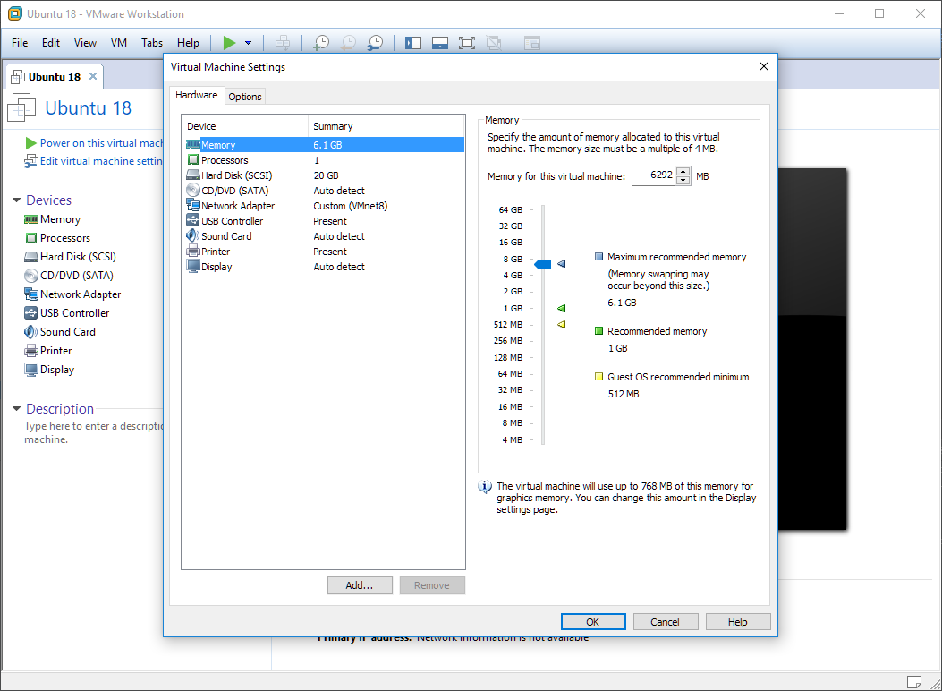
VM 메모리 설정
메모리를 최대 추천 메모리 크기로 설정.

Slide 13
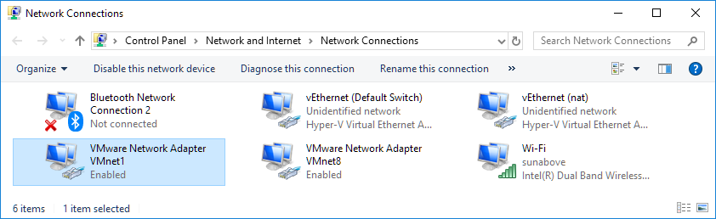
VMWare Network Adapter
WindowKey + X -> Settings -> Network & Internet -> Change adaptor options
Default
Virtual VMWare
Network Adapter
Physical Wi-Fi
Network Adapter

Slide 14
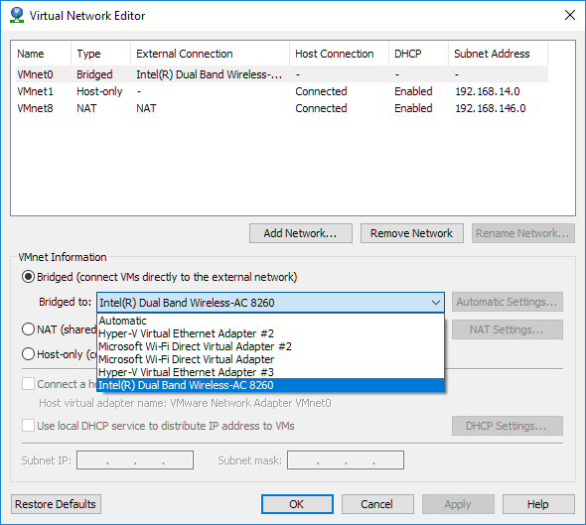
VM Virtual Network 설정
모든 VM을 중지한다.
Edit -> Virtual Network Editor -> Change Settings
Virtual Network Editor의 VMNet0 확인
Type: Bridged
External Connection : Intel® Dual Band ….
노트북의 무선 네트웍 장치명을 선택
필요시 초기화

Slide 15
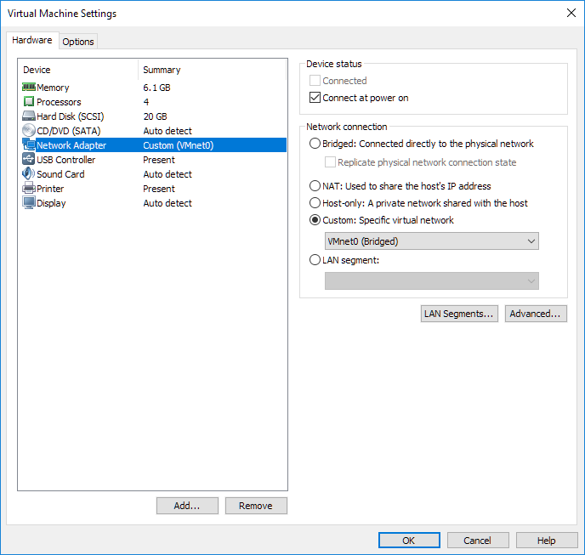
VM Network Adapter 설정
모든 VM을 중지한다.
Edit Virtual Machine Settings -> Network Adaptor 클릭
Network Connection
Custom 체크 -> VNet0 (Bridged) 선택 -> Ok 클릭

Slide 16
bash 설정
환경변수 조회
printenv
PATH 환경 변수 조회
printenv | grep PATH
echo $PATH
현재 폴더를 PATH에 추가하기
사용자 홈 디렉토리의 .bashrc 파일 마지막 줄에 아래의 문장을 추가한다.
export PATH=$PATH:.

Slide 17
강의 개요
* 강의 빈도수
Kernel *
System Call ****
C Programming ***
Unix(Linux) **

Slide 18
Linux 개요 및 역사
리누스 토발즈가 개발한 Linux는 커널(kernel)을 뜻하지만, Linux 커널과 라이브러리와 도구들이 포함된 운영 체제를 뜻하기도 한다. Linux는 다중 사용자, 다중 작업, 다중 스레드를 지원하는 운영 체제이다.
Linux는 1991년 9월 인터넷을 통해 처음 공개되었다. 초기 Linux는 개인 개발자에 의해 개발되었으나, 이후 IBM, HP와 같은 기업의 후원을 받으면서 유닉스와 마이크로소프트 윈도우 운영 체제의 대안이 되었다. Linux는 오픈 소스의 특성에 힘입어 다양한 Linux 기반의 운영 체제가 배포되었다.
Linux는 벤더 독립성, 적은 개발비, 보안성 및 안전성으로 데스크톱 운영 체제로서도 인기가 높아지고 있다.
Linux는 인텔 386 CPU를 위해 개발되었으나, 현재는 개인용 컴퓨터에서 부터 슈퍼컴퓨터는 물론 스마트폰과 같은 임베디드 시스템까지 이용되고 있다. 구글의 안드로이드는 대표적인 임베디드 Linux 운영 체제이다.
출처: https://ko.wikipedia.org/wiki/Linux

Slide 19



논리적 / 물리적
논리적 / Logical
사람의 생각으로 만든 것
물리적 / Physical
관찰 또는 측정이 가능 한 것

Slide 20
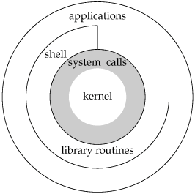
A Linux System Architecture Diagram

Slide 21
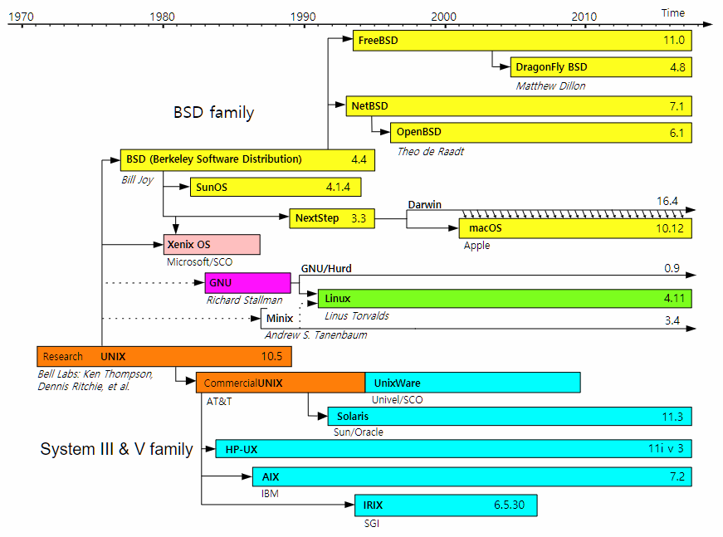
Unix History

Slide 22
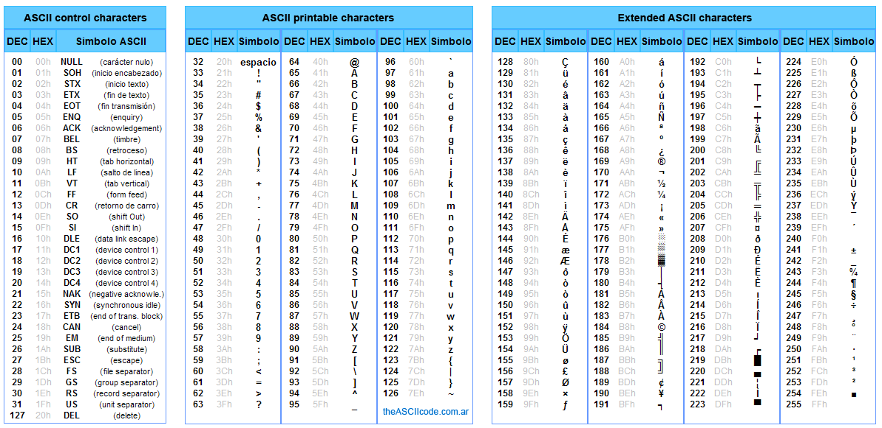
ACII CODE Extended

Slide 23
Linux runlevel
A runlevel is one of the modes that a Unix -based operating system will run in. Each runlevel has a certain number of services stopped or started, giving the user control over the behavior of the machine.
Level | Mode | Action
0 | Halt | Shuts down system
1 | Single-User | Mode for administrative tasks.
2 | Multi-User | Does not configure network interfaces or start daemons.
3 | Multi-User with Networking | Starts the system normally.
4 | Not used | Not used/User-definable for special purposes
5 | X11 | As runlevel 3 + display manager(X)
6 | Reboot | Reboots the system
s or S | Single-User | Does not configure network interfaces, or start daemons.

Slide 24
Linux booting
디스크 동기화
sync
중지 명령어들
init 0
poweroff
halt
shutdown now
리부팅 명령어들
reboot
init 6

Slide 25

Linux 주요 명령어
Linux 주요 명령어
http://www.usm.uni-muenchen.de/people/puls/lessons/intro_general/Linux/Linux_for_beginners.pdf
Book
Unix Power Tools, 3rd ed.
By Mike Loukides
Publisher: O'Reilly Media
Release Date: February 2009
Pages: 1160
http://shop.oreilly.com/product/9780596003302.do

Slide 26
User/Group
유닉스의 사용자는 홈 디렉터리를 가진다.
파일을 조회/수정/실행에 관한 권한을 가진다.
sudo addgroup newGroup : 그룹 추가
sudo useradd -g newGroup --create-home newUser : 사용자 추가
sudo passwd newUser : 사용자 패스워드 설정
sudo usermod –g newGroup newUser : 사용자 그룹변경

Slide 27
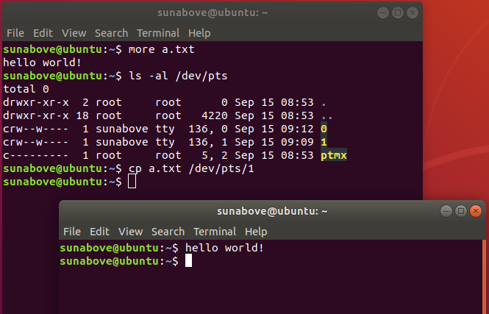
File
Unix Philosophy : Everything is file.
Unix는 파일과 디바이스 및 폴더가 동등한 개념이다.

Slide 28
C Programming Language
An Introduction to the C Programming Language and Software Design
http://www-personal.acfr.usyd.edu.au/tbailey/ctext/ctext.pdf

Slide 29
First C Program (p.3)
/* File Name : hello.c */
/* First C program: Hello World */
#include <stdio.h>
int main( int argc , char ** argv )
{
printf( "Hello World!\n" );
return 0 ;
}

Slide 30
printf
Syntax
int printf( const char *format [, arg]... );
Prints formatted output to the standard output stream.
If format includes format specifiers (subsequences beginning with %), the additional arguments following format are formatted and inserted in the resulting string replacing their respective specifiers.
참고 자료
http://www.cypress.com/file/54441/download

Slide 31
printf functions
option\target | stdout | file | string
 | printf | fprintf | sprintf
w | wprintf | fwprintf | swprintf | wide-character
n |  |  | snprintf
nw |  |  | snwprintf
No. | Synstax
1 | int printf ( const char *format [, argument] ... );
2 | int fprintf ( FILE *stream, const char *format [, argument] ... );
3 | int sprintf ( char *buffer, const char *format [, argument] ... );
4 | int snprintf( char *buffer, size_t count, const char *format [, argument] ... );

Slide 32
Error Handling
CHAPTER 1

Slide 33


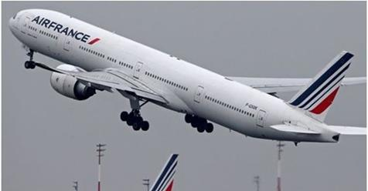

Why is an Error Handling important?
삼성증권 최악의 배당 사고.
주당 1000원을 배당해야 하는데, 전산실수로 주당 1000주(4000만원 상당)가 배정됐다.
잘못 부여된 주식배당 물량이 113조원에 이른다.
유로컨트롤 "2만9천500편 가운데 절반 정도 이착륙 지연"
"1만 5,000대 비행기 발 묶여" 유럽 항공대란
유럽 항공교통 통제기구 기술적 문제
항공기 이착륙 지연, 공항마다 큰 혼잡
페이스북, 데이터 유출 사고
페이스북 계정 8,700만 건의 데이터가 미국 대선을 위한 타깃 광고에 부적절하게 활용된 사건
Intel CPU Meltdown 버그
“CPU들이 성능을 최적화하기 위해 적용하는 ‘추측 실행’(speculative execution) 기술로 인해 발생하는 심각한 보안 결함.
“허가 받지 않은 프로세스가 시스템 메모리에서 비밀번호나 암호화 열쇠 또는 다른 애플리케이션에 열려 있는 민감한 정보를 읽을 수 있다.

Slide 34
Error Handling (p. 21)
In system programming, an error is signified via a function’s return value and described via a special variable, errno.
This variable is declared in <errno.h> as follows:
extern int errno ;
Erros and their descriptions
Table 1-2
errno
In single-thread, errno is a global variable.
In multi-threas, errno is stored per-thread, and is thus threadsafe.

Slide 35
errno must be zeroed. (p. 23)
errno must be zeroed before invocation and checked afterward.
errno = 0;
ul = strtoul(buf, NULL, 0);
if( errno ){
perror ("strtoul");
}

Slide 36
(2) Error reporting (p. 23)
Name | strerror( )
Desc | return string describing error number
Desc | The strerror() function returns a pointer to a string that describes the error code passed in the argument errnum, possibly using the LC_MESSAGES part of the current locale to select the appropriate language. (For example, if errnum is EINVAL, the returned description will be "Invalid argument".) This string must not be modified by the application, but may be modified by a subsequent call to strerror() or strerror_l(). No other library function will modify this string.
Synopsis | #include <stdio.h> char * strerror( int errnum );
Example | char * error_message = strerror( errnum ) ;

Slide 37
(1) Error reporting (p. 22)
Name | perror( )
Desc | print a system error message
Desc | The perror( ) function produces a message on standard error describing the last error encountered during a call to a system or library function.
Synopsis | #include <stdio.h> void perror (const char *str);
Example | if (close (fd) == −1) perror ("close");

Slide 38
(3) Error reporting (p. 23)
Name | strerror_r
Desc | return string describing error number
Desc | The strerror_r() function is similar to strerror(), but is thread safe. A call to strerror_r() returns 0 on success, and −1 on failure. Humorously, it sets errno on error.
Synopsis | #include <string.h> int strerror_r (int errnum, char *buf, size_t len);
Ex. | char buf[100]; int err = strerror_r (errnum, buf, sizeof( buf ) );

Slide 39
(4) fflush (p. 82)
Name | fflush( )
Desc | flush a stream
Desc | For output streams, fflush() forces a write of all user-space buffered data for the given output or update stream via the stream's underlying write function.
Synopsis | #include <stdio.h> int fflush(FILE * stream);
Return value | Upon successful completion 0 is returned. Otherwise, EOF is returned and errno is set to indicate the error.
Example | fflush ( stdout );

Slide 40
perror( ) / strerror( ) Example
int main(int argc, char ** argv) {
int fd = -1;
errno = 0; // Always Reset errno before use.
printf( "\nTrying to open a file...." ) ;
fd = open("abcd",O_RDONLY);
if(fd == -1) {
printf( "\nerrono: %d" , errno );
printf("\nstrerror() : %s", strerror(errno) );
} else {
printf( "\nSuccess: open the file." );
}
return 0;
}

Slide 41
preserve errno across function call. (p. 23)
if (fsync (fd) == −1) {
fprintf (stderr, "fsync failed!\n");
if (errno == EIO)
fprintf (stderr, "I/O error on %d!\n", fd);
}
if (fsync (fd) == −1) {
const int err = errno;
fprintf (stderr, "fsync failed: %s\n", strerror (errno));
if (err == EIO) {
/* if the error is I/O-related, jump ship */
fprintf (stderr, "I/O error on %d!\n", fd);
exit (EXIT_FAILURE);
}
}

Slide 42
FILE I/O
CHAPTER 2

Slide 43
Chapter Overview (p. 25)
This and the subsequent three chapters cover files.
This chapter covers the basics of file I/O.
Chapter 3
standard I/O from the standard C library.
Chapter 4
the more advanced and specialized file I/O.
Chapter 8
file and directory manipulation.

Slide 44
File descriptor 1/3 (p. 25)
Before a file can be read from or written to, it must be opened.
The kernel maintains a per-process list of open files, called the file table.
This table is indexed via nonnegative integers known as file descriptors (fds).
Each entry in the list contains information about an open file, including a pointer to an in-memory copy of the file’s backing inode and associated metadata, such as the file position and access modes.

Slide 45
File descriptor 2/3 (p. 25)
Because negative values are not legal file descriptors, −1 is often used to indicate an error from a function.
Unless the process explicitly closes them, every process by convention has at least three file descriptors open: 0, 1, and 2.
File descriptor 0 is standard in (stdin), file descriptor 1 is standard out (stdout), and file descriptor 2 is standard error (stderr).
Instead of referencing these integers directly, the C library provides the preprocessor defines STDIN_FILENO, STDOUT_FILENO, and STDERR_FILENO, respectively.
Normally, stdin is connected to the terminal’s input device (keyboard) and stdout and stderr are connected to the terminal’s display.
Users can redirect these standard file descriptors and even pipe the output of one program into the input of another. This is how the shell implements redirections and pipes.

Slide 46
File descriptor 3/3 (p. 26)
File descriptors can reference more than just regular files.
File descriptors are used for accessing device files and pipes, directories and futexes, FIFOs and sockets.
It follows the everything-is-a-file philosophy.
Anything you can read or write is accessible via a file descriptor.

Slide 47
Opening Files (p. 26)
#include <sys/types.h>
#include <sys/stat.h>
#include <fcntl.h>
#include <unistd.h>
int main( int argc , char ** argv ) {
int fd = -1;
fd = open("/home/kidd/madagascar", O_RDONLY);
if ( -1 == fd ) {
/* error */
fprintf( stdout, "file open error/" );
} else {
fprintf( stdout, "file open success." );
// closes a file descriptor and may be reused.
close( fd );
}
}

Slide 48
open (p. 26)
Name | open ( )
Desc | A file is opened and a file descriptor is obtained. If the specified file does not exist, it may optionally (if O_CREAT is specified in flags) be created by open().
Synopsis | #include <sys/types.h> #include <sys/stat.h> #include <fcntl.h> int open(const char *name, int flags); int open(const char *name, int flags, mode_t mode);
Return | A file descriptor, a small, nonnegative integer.
Example | int fd = open("/home/kidd/madagascar", O_RDONLY); O_RDONLY : reading only. O_WRONLY : writing only. O_RDWR : reading and writing.

Slide 49
create (p. 31)
Name | creat( )
Desc | create a new file or rewrite an existing one
Desc | The function call: creat(path, mode) shall be equivalent to: open(path, O_WRONLY|O_CREAT|O_TRUNC, mode)
Synopsis | #include <sys/types.h> #include <sys/stat.h> #include <fcntl.h> int creat(const char *name mode_t mode);
Return | A file descriptor, a small, nonnegative integer.
Example | int fd = creat( filename, 0644 ); if (fd == −1) /* error */

Slide 50
read (p. 32)
Name | read( )
Desc | read() attempts to read up to count bytes from file descriptor fd into the buffer starting at buf.
Synopsis | #include <unistd.h> ssize_t read (int fd, void *buf, size_t len);
Return value | On success, the number of bytes read is returned (zero indicates end of file), and the file position is advanced by this number. It is not an error if this number is smaller than the number of bytes requested; this may happen for example because fewer bytes are actually available right now (maybe because we were close to end-of-file, or because we are reading from a pipe, or from a terminal), or because read() was interrupted by a signal. On error, -1 is returned, and errno is set appropriately. In this case it is left unspecified whether the file position (if any) changes. If count is greater than SSIZE_MAX, the result is unspecified.
Example

Slide 51
write (p. 36)
Name | write( )
Desc | write() writes up to count bytes from the buffer starting at buf to the file referred to by the file descriptor fd.
Synopsis | #include <unistd.h> ssize_t write (int fd, const void *buf, size_t count);
Return value | On success, the number of bytes written is returned (zero indicates nothing was written). It is not an error if this number is smaller than the number of bytes requested; this may happen for example because the disk device was filled. On error, -1 is returned, and errno is set appropriately. If count is zero and fd refers to a regular file, then write() may return a failure status if one of the errors below is detected. If no errors are detected, or error detection is not performed, 0 will be returned without causing any other effect. If count is zero and fd refers to a file other than a regular file, the results are not specified.
Example

Slide 52
lseek (p. 46)
Name | lseek( )
Desc | lseek - reposition read/write file offset
Synopsis | #include <sys/types.h> #include <unistd.h> off_t lseek(int fd, off_t offset, int whence);
Description | lseek() repositions the file offset of the file descriptor fd to the argument offset according to the directive whence as follows: SEEK_SET The file offset is set to offset bytes. SEEK_CUR The file offset is set to its current location plus offset bytes. SEEK_END The file offset is set to the size of the file plus offset bytes. lseek() allows the file offset to be set beyond the end of the file (but this does not change the size of the file). If data is later written at this point, subsequent reads of the data in the gap (a "hole") return null bytes ('\0') until data is actually written into the gap.
Return Value | Upon successful completion, lseek() returns the resulting offset location as measured in bytes from the beginning of the file. On error, the value (off_t) -1 is returned and errno is set to indicate the error.

Slide 53
close (p. 45)
Name | close( )
Desc | unmap the file de‐scriptor from the associated file
Synopsis | #include <unistd.h> int close( int fd );
Return value | A call to close() unmaps the open file descriptor fd and disassociates the file from the process. The given file descriptor is then no longer valid, and the kernel is free to reuse it as the return value to a subsequent open() or creat() call. A call to close() returns 0 on success. On error, it returns −1 and sets errno appropriately. Note that closing a file has no bearing on when the file is flushed to disk. To ensure that a file is committed to disk before closing it, an application needs to make use of one of the synchronization options discussed earlier in “Synchronized I/O” on page 40.
Example | if (close (fd) == -1) perror ("close");

Slide 54
Opening Files (p. 26)
Flags for open( )
The flags argument is the bitwise-OR of one or more flags.
It must contain an access mode, which is one of O_RDONLY, O_WRONLY, or O_RDWR.
Respectively, these arguments request that the file be opened only for reading, only for writing, or for both reading and writing.
Flag Detail : (p. 27~ 28)
int fd; fd = open ("/home/teach/pearl", O_WRONLY | O_TRUNC); if (fd == -1) /* error */

Slide 55
Owners of New Files (p. 29)
Determining which user owns a new file is straightforward: the uid of the file’s owner is the effective uid of the process creating the file.
Determining the owning group is more complicated. The default behavior is to set the file’s group to the effective gid of the process creating the file.
Thankfully, you often need not care what group owns a file.

Slide 56
Permissions of New File (p. 29)
The mode argument is ignored unless a file is created; it is required if O_CREAT is given.
If you forget to provide the mode argument when using O_CREAT, the results are undefined and often quite ugly—so don’t forget!
When a file is created, the mode argument provides the permissions of the newly created file.
The mode is not checked on this particular open of the file, so you can perform operations that contradict the assigned permissions, such as opening the file for writing but assigning the file read-only permissions.
The mode argument is the familiar Unix permission bitset, such as octal 0644.
int open (const char *name, int flags); int open (const char *name, int flags, mode_t mode);

Slide 57
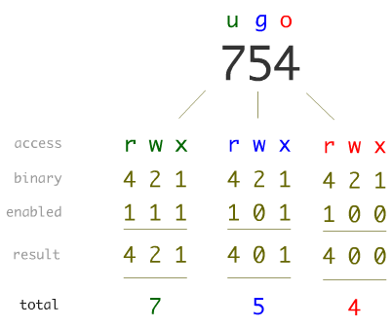
Unix File Permission

Slide 58
File open example (p. 31)
As an example, the following code opens the file given by file for writing.
If the file does not exist, assuming a umask of 022, it is created with the permissions 0644 (even though the mode argument specifies 0664). If it does exist, it is truncated to zero length:
fd = open (file, O_WRONLY|O_CREAT|O_TRUNC ,
S_IWUSR|S_IRUSR|S_IWGRP|S_IRGRP|S_IROTH);
fd = open (file, O_WRONLY|O_CREAT|O_TRUNC, 0664);

Slide 59
The creat( ) Function (p. 31)
The combination of O_WRONLY | O_CREAT | O_TRUNC is so common that a system call exists to provide just that behavior:
int creat (const char *name, mode_t mode);
It can be implemented in user space as simply:
int creat (const char *name, int mode) { return open (name, O_WRONLY | O_CREAT | O_TRUNC, mode); }
Return Values and Error Codes
Both open() and creat() return a file descriptor on success.
On error, both return −1, and set errno to an appropriate error value

Slide 60
Reading via read( ) (p. 32)
Syntax #include <unistd.h> ssize_t read (int fd, void *buf, size_t len);
A call try to read up to len bytes into the buf .
On success, the number of bytes written into buf is returned.
On error, the call returns -1 and sets errno.
The file position is advanced by the number of bytes read from fd.

Slide 61
Example of read( ) (p. 32)
The number of bytes to read is equal to the size of the unsigned long type.
4 bytes on 32-bit systems
8 bytes on 64-bit systems.
nr contains the number of bytes read success, or −1 on error:
The call might return without reading all len bytes.
unsigned long word; ssize_t nr; nr = read (fd, &word, sizeof(unsigned long)); if (nr == -1) /* error */

Slide 62
Return values of read() ½ (p. 33)
It is legal for read() to return a positive nonzero value less than len.
less than len bytes may have been available.
interrupted by a signal, and so on.
The possibility of a return value of 0
The read() system call returns 0 to indicate end-of-file (EOF);
No bytes were read.
EOF is not an error.
Blocking Mode : Sleep
If a call is made for len bytes, but no bytes are available for reading, the call will block until the bytes become available.
In the case of blocking, the read is waiting for more data
in the case of reading from a socket or a device file.

Slide 63
Return values of read( ) 2/2 (p. 33)
The call returns a value equal to len. All len read bytes are stored in buf.
The call returns a value less than len, but greater than zero.
Reissuing the read will read the remaining bytes into the rest of the buffer.
The call blocks when no data is currently available.
This won’t happen in non‐blocking mode.
The call returns -1
errno == EINTR
A signal was re‐ceived before any bytes were read.
errno == EAGAIN
The read would block because no data is currently available.
The request should be reissued later.
Another errno
A more serious error.

Slide 64
Reading All the Bytes (p. 34)
It handles all errors and actually read all len bytes (at least up to an EOF).
ssize_t ret; while (len != 0 && (ret = read (fd, buf, len)) != 0) { if (ret == -1) { if (errno == EINTR) { // signal interrup continue;
} perror ("read"); break; } len -= ret; buf += ret; }

Slide 65
Nonblocking Reads ½ (p. 35)
Sometimes, programmers do not want a call to read() to block when there is no data available.
Instead, they prefer that the call return immediately, indicating that no data is available.
Nonblocking I/O allows applications to perform I/O on multiple files.

Slide 66
Nonblocking Reads 2/2 (p. 35)
An additional errno value EAGAIN is worth checking:.
if O_NONBLOCK was given to open()
char buf[BUFSIZ]; ssize_t nr; start: nr = read (fd, buf, BUFSIZ); if (nr == -1) { if (errno == EINTR) // signal interrupt goto start; /* oh shush */ if (errno == EAGAIN) /* resubmit later */ else /* error */ }

Slide 67
Other Error Values (p. 35)
EBADF
The given file descriptor is invalid or is not open for reading.
EFAULT
The pointer provided by buf is not inside the calling process’s address space.
EINVAL
The file descriptor is mapped to an object that does not allow reading.
EIO
A low-level I/O error occurred.

Slide 68
ssize_t (p. 36)
The size_t and ssize_t types are mandated by POSIX.
The size_t type is used for storing values used to measure size in bytes.
The ssize_t type is a signed version of size_t.
On 32-bit systems, the backing C types are usually unsigned int and int, respectively.
Because the two types are often used together, the potentially smaller range of ssize_t places a limit on the range of size_t.

Slide 69
Size Limits on read() (p. 36)
The maximum value of a size_t is SIZE_MAX;
If len is larger than SSIZE_MAX, the results of the call to read() are undefined.
On most Linux systems, SSIZE_MAX is LONG_MAX, which is 2,147,483,647 on a 32-bit machine.
if (len > SSIZE_MAX) { len = SSIZE_MAX;
}

Slide 70
Writing with write() ½ (p. 36)
write() is the counterpart of read() .
#include <unistd.h>
ssize_t write (int fd, const void *buf, size_t count);
A call to write() writes up to count bytes starting at buf.
Return Value
On success :
the number of bytes written is returned
and the file position is updated in kind.
return 0 :
it simply implies that zero bytes were written.
On error
−1 is returned and errno is set appropriately.

Slide 71
Writing with write() 2/2 (p. 37)
Basic usage
const char *buf = "My ship is solid!"; ssize_t nr; /* write the string in 'buf' to 'fd' */ nr = write (fd, buf, strlen (buf)); if (nr == -1) /* error */
Partial Write
unsigned long word = 1720; size_t count; ssize_t nr; count = sizeof (word); nr = write (fd, &word, count); if (nr == -1) /* error, check errno */ else if (nr != count) /* possible error, but 'errno' not set */

Slide 72
Partial Writes (p. 37)
The write() system call is less likely to return a partial write than the read().
For regular files
write() is guaranteed to perform the entire requested write.
For other file types like sockets
a loop may be required to guarantee that you really write out all of the requested bytes.
ssize_t ret, nr; while (len != 0 && (ret = write (fd, buf, len)) != 0) { if (ret == -1) { if (errno == EINTR) continue; perror ("write"); break;
} len -= ret; buf += ret; }

Slide 73
Append Mode (p. 38)
When fd is opened in append mode (via O_APPEND),
Writings occur at the current end of the file.

Slide 74
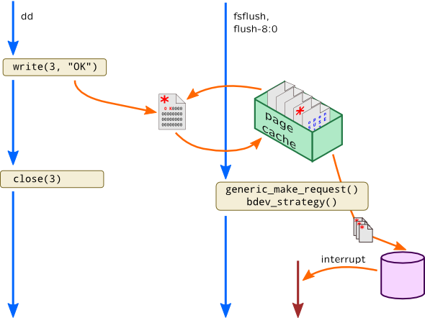
Behavior of write() (p. 39)
When a call to write(),
the kernel has copied the data from the supplied buffer into a kernel buffer
there is no guarantee that the data has been written out to its destination.
Later, in the background,
the kernel gathers up all of the dirty buffers
writes them out to disk.

Slide 75
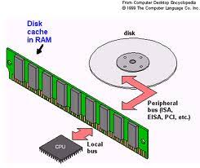
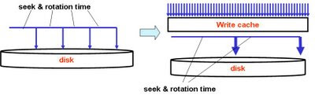
Synchronized I/O (p. 40)
Buffering writes provides a significant performance improvement.
A fsync() ensures that data has reached the disk.
#include <unistd.h>
int fsync (int fd);
In the presence of hard disks with write caches,
it is not possible for fsync() to know whether the data is physically on the disk.
The hard drive can report that the data was written, but the data may reside in the drive’s cache.
A call to fdatasync() does the same thing as fsync().
The call does not guarantee that nonessential metadata is synchronized to disk.
#include <unistd.h>
int fdatasync (int fd);

Slide 76
sync() (p. 43)
The sync() system call is provided for synchronizing all buffers to disk:
#include <unistd.h>
void sync (void);
The function has no parameters and no return value.
It always succeeds and, upon return, all buffers—both data and metadata—are guaranteed to reside on disk.

Slide 77
The O_SYNC Flag (p. 43)
The O_SYNC flag may be passed to open(), indicating that all I/O on the file should be synchronized:
int fd = open (file, O_WRONLY | O_SYNC);
Read requests are always synchronized.
However, calls to write() are normally not synchronized.

Slide 78
Direct I/O
Providing the O_DIRECT flag to open()
minimize the presence of I/O management.
Direct I/O will initiate directly from user-space buffers to the device, bypassing the page cache.
Direct I/O will be synchronous.
operations will not return until completed.
The request length, buffer alignment, and file offsets must be integer multiples of the device’s sector size.
generally, this is 512 bytes.

Slide 79
Seeking with lseek() ½ (p. 46)
The lseek() system call is provided to set the file position of a file descriptor to a given value.
#include <sys/types.h>
#include <unistd.h>
off_t lseek(int fd,off_t pos,int origin);
The origin argument
SEEK_CUR
The file position is set to its current value plus pos.
SEEK_END
The file position is set to the length of the file plus pos.
SEEK_SET
The file position is set to pos.

Slide 80
Seeking with lseek() 2/2 (p. 47)
Set the file position of fd
off_t ret;
ret = lseek (fd, (off_t) 1825, SEEK_SET);
if (ret == (off_t) −1) /* error */
Set the file position of fd to the end of the file:
off_t ret;
ret = lseek (fd, 0, SEEK_END);
if (ret == (off_t) −1) /* error */
As lseek() can be used to find the current file position:
int pos;
pos = lseek (fd, 0, SEEK_CUR);
if (pos == (off_t) −1) /* error */

Slide 81
실습: 파일 복사 프로그램 작성
c main function argc, argv
example : a05_argument.c
read(), write() 함수를 이용하여 파일을 복사하는 프로그램을 작성하세요.
소스 파일 이름: file_copy.c
프로그램 내용:
실행 프로그램의 두 번재 argument 값의 파일의 내용을 세번째 argument 값의 파일로 복사한다.

Slide 82
Buffered I/O
CHAPTER 3

Slide 83
Buffered I/O
Buffered I/O
= User-Buffered I/O
= Standard C I/O
= stdio
= File Pointer
= FILE * file
= stream
fopen() , fread(), fwrite() , fclose()

Slide 84
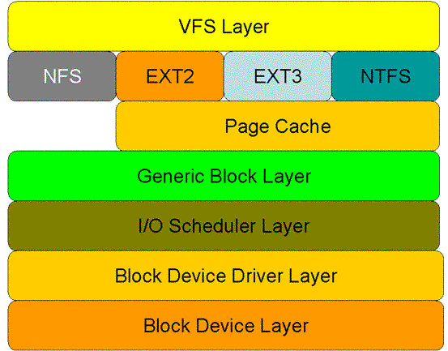
Block (p. 67)
The block is an abstraction representing the smallest unit of storage on a filesystem.
Inside the kernel, all filesystem operations occur in terms of blocks.
No I/O operation may execute on an amount of data less than the block size or that is not an integer multiple of the block size.
If you only want to read a byte, too bad:
you’ll have to read a whole block.
Want to write 4.5 blocks worth of data?
You’ll need to write 5 blocks, which implies reading that partial block in its entirety, updating only the half you’ve changed, and then writing back the whole block.

Slide 85
User-Buffered I/O (p. 67)
Programs that have to issue many small I/O requests to regular files often perform user-buffered I/O.
Buffered I/O refers to buffering done in user space, either manually by the application or transparently in a library, not to buffering done by the kernel.
In practice, blocks are usually 512, 1,024, 2,048, 4,096, or 8,192 bytes in size.
User-buffered I/O closes the gap between the filesystem, which speaks in blocks, and the application, which talks in its own abstractions.

Slide 86
C Standard I/O (p. 70)
The standard C library provides the standard I/O library (often simply called stdio).
It provides a platform-independent, user-buffering solution.
The standard I/O library is simple to use, yet powerful.
The remainder of this chapter discusses user-buffered I/O as it pertains to file I/O.
It is implemented in the standard C library.
Opening, closing, reading, and writing files via the standard C library.

Slide 87

File Pointers (p. 70)
Standard I/O routines do not operate directly on file descriptors.
SIO use their own unique identifier, known as the file pointer.
The file pointer maps to a file descriptor.
The file pointer is represented by a pointer to the FILE typedef.
An open file is called a stream.
Streams may be opened for reading (input streams), writing (output streams), or both (input/output streams).

Slide 88
Opening Files (p. 71)
Files are opened for reading or writing via fopen():
#include <stdio.h>
FILE * fopen (const char *path, const char *mode);
This function opens the file path with the behavior given by mode and associates a new stream with it.
Modes : The mode argument describes how to open the given file.
r : Open the file for reading.
r+ : Open the file for both reading and writing.
w : Open the file for writing.
If the file exists, it is truncated to zero length. If the file does not exist, it is created.
w+ : Open the file for both reading and writing.
If the file exists, it is truncated to zero length. If the file does not exist, it is created.
a : Open the file for writing in append mode.
The file is created if it does not exist. The stream is positioned at the end of the file.
a+ : Open the file for both reading and writing in append mode.
The file is created if it does not exist. The stream is positioned at the end of the file.

Slide 89
Opening Files (p. 72)
Example
FILE *stream;
stream = fopen ("/etc/manifest", "r");
if(!stream)
/* error */
Opening a Stream via File Descriptor
The function fdopen() converts an already open file descriptor (fd) to a stream:
#include <stdio.h>
FILE * fdopen(int fd, const char *mode);

Slide 90
Closing Streams (p. 73)
The fclose() function closes a given stream:
#include <stdio.h>
int fclose(FILE *stream);
Any buffered and not-yet-written data is first flushed. On success, fclose() returns 0.
On failure, it returns EOF and sets errno appropriately.

Slide 91
Closing All Streams (p. 73)
The fcloseall() function closes all streams associated with the current process, including standard in, standard out, and standard error:
#define _GNU_SOURCE
#include <stdio.h>
int fcloseall (void);
Before closing, all streams are flushed.
The function always returns 0.
it is Linux-specific.

Slide 92
Reading from a Stream (p. 74)
The function fgetc() is used to read a single character from a stream:
#include <stdio.h>
int fgetc (FILE *stream);
This function reads the next character from stream and returns it as an unsigned char cast to an int.
Example
int c;
c = fgetc(stream);
if (c == EOF)
/* error */
else
printf ("c=%c\n", (char) c);

Slide 93
Putting the character back (p. 74)
Standard I/O provides a function for pushing a character back onto a stream,
#include <stdio.h>
int ungetc (int c, FILE *stream);
Each call pushes back c, cast to an unsigned char, onto stream.
On success, c is returned;
on failure, EOF is returned. A subsequent read from stream will return c.

Slide 94
Reading an Entire Line (p. 75)
The function fgets() reads a string from a given stream:
#include <stdio.h>
char * fgets (char *str, int size, FILE *stream);
This function reads up to one less than size bytes from stream and stores the results in str. A null character (\0) is stored in the buffer after the last byte read in.
Reading stops after an EOF or a newline character is reached.
If a newline is read, the \n is stored in str.
On success, str is returned; on failure, NULL is returned. For example: char buf[LINE_MAX]; if (!fgets (buf, LINE_MAX, stream)) /* error */

Slide 95
Reading arbitrary string ½ (p. 75)
Sometimes, developers want to use a delimiter other than the newline. Other times, developers do not want a delimiter at all—and rarely do developers want the delimiter stored in the buffer!
This snippet reads the n − 1 bytes from stream into str, and then appends a \0 character.
char *s;
int c;
s = str;
while (--n > 0 && (c = fgetc (stream)) != EOF) {
*s++ = c;
}
*s = '\0';
Ex :

Slide 96
Reading arbitrary string 2/2 (p. 76)
The snippet can be expanded to also stop reading at a delimiter, given by the integer d (which cannot be the null character in this example):
char *s;
int c = 0;
s = str;
while (--n > 0 && (c = fgetc (stream)) != EOF && (*s++ = c) != d) {
// do nothing.
} ;
if (c == d) {
*--s = '\0';
} else {
*s = '\0';
}
Ex :

Slide 97
Reading Binary Data (p. 75)
Developers want to read and write complex binary data, such as C structures.
#include <stdio.h>
size_t fread (void *buf, size_t size, size_t nr, FILE *stream);
A call to fread() will read up to nr elements of data, each of size bytes, from stream into the buffer pointed at by buf.
The number of elements read (not the number of bytes read!) is returned.
The function indicates failure or EOF via a return value less than nr.
Ex :
char buf[64];
size_t nr;
nr = fread (buf, sizeof(buf), 1, stream);
if (nr == 0)
/* error */

Slide 98
Writing a single character (p. 78)
The counterpart of fgetc() is fputc():
#include <stdio.h>
int fputc (int c, FILE *stream);
The fputc() function writes the byte specified by c (cast to an unsigned char) to the stream pointed at by stream.
Upon successful completion, the function returns c.
Otherwise, it returns EOF, and errno is set appropriately.
Example :
if (fputc ('p', stream) == EOF)
/* error */

Slide 99
Wring a String of Characters (p. 78)
The function fputs() is used to write an entire string to a given stream:
#include <stdio.h>
int fputs (const char *str, FILE *stream);
A call to fputs() writes all of the null-terminated string pointed at by str to the stream pointed at by stream.
On success, fputs() returns a nonnegative number.
On failure, it returns EOF.
Ex :
FILE *stream;
stream = fopen ("journal.txt", "a");
if (!stream)
/* error */
if (fputs("The ship is made of wood.\n", stream) == EOF)
/* error */
if (fclose (stream) == EOF)
/* error */

Slide 100
Writing Binary Data (p. 79)
To directly store binary data, standard I/O provides fwrite():
#include <stdio.h>
size_t fwrite (void *buf, size_t size, size_t nr, FILE *stream);
A call to fwrite() will write to stream up to nr elements, each size bytes in length, from the data pointed at by buf.
The file pointer will be advanced by the total number of bytes written.
The number of elements (not the number of bytes!) successfully written will be returned.
A return value less than nr denotes error.

Slide 101
Sample Program Using Buffered I/O 1/3 (p. 79)
This program first defines struct pirate and then declares two variables of that type.
The program initializes one of the variables and subsequently writes it out to disk via an output stream to the file data.
Via a different stream, the program reads the data back in from data directly to the other instance of struct pirate.
Finally, the program writes the contents of the structure to standard out:

Slide 102
Sample Program Using Buffered I/O 2/3 (p. 79)
#include <stdio.h>
int main (void) {
FILE *in, *out;
struct pirate {
char name[100]; /* real name */
unsigned long booty; /* in pounds sterling */
unsigned int beard_len; /* in inches */
} ;
pirate p, blackbeard = { "Edward Teach", 950, 48 };
out = fopen ("data.txt", "w");
if (!out) {
perror ("fopen");
return 1;
}
if (!fwrite (&blackbeard, sizeof(struct pirate), 1, out)) {
perror ("fwrite");
return 1;
}

Slide 103
Sample Program Using Buffered I/O 3/3 (p. 80)
if (fclose (out)) {
perror ("fclose");
return 1;
}
in = fopen ("data.txt", "r");
if (!in) {
perror ("fopen");
return 1;
}
if (!fread (&p, sizeof (struct pirate), 1, in)) {
perror ("fread");
return 1;
}
if (fclose (in)) {
perror ("fclose");
return 1;
}
printf ("name=\"%s\" booty=%lu beard_len=%u\n", p.name, p.booty, p.beard_len);
return 0;
}

Slide 104
Seeking a stream (p. 80)
The fseek() function manipulates the file position of stream in accordance with offset and whence:
#include <stdio.h>
int fseek (FILE *stream, long offset, int whence);
If whence is set to SEEK_SET, the file position is set to offset.
If whence is set to SEEK_CUR, the file position is set to the current position plus offset.
If whence is set to SEEK_END, the file position is set to the end of the file plus offset.
Upon successful completion, fseek() returns 0, clears the EOF indicator, and undoes the effects (if any) of ungetc().
On error, it returns −1, and errno is set appropriately.
The most common errors are invalid stream (EBADF) and invalid whence argument (EINVAL).

Slide 105
Obtaining the Current Stream Position( p. 82)
Unlike lseek(), fseek() does not return the updated position. A separate interface is provided for this purpose. The ftell() function returns the current stream position of stream:
#include <stdio.h>
long ftell (FILE *stream);
On error, it returns −1 and errno is set appropriately.

Slide 106
Flushing a Stream ½ (p. 82)
The standard I/O library provides an interface for writing out the user buffer to the kernel, ensuring that all data written to a stream is flushed via write().
#include <stdio.h>
int fflush (FILE *stream);
On invocation, any unwritten data in the stream pointed to by stream is flushed to the kernel.
If stream is NULL, all open input streams in the process are flushed.
On success, fflush() returns 0.
On failure, it returns EOF, and errno is set appropriately.
To understand the effect of fflush(), you have to understand the difference between the buffer maintained by the C library and the kernel’s own buffering.
All of the calls described in this chapter work with a buffer that is maintained by the C library, which resides in user space, not kernel space.
That is where the performance improvement comes in—you are staying in user space and therefore running user code, not issuing system calls.
A system call is issued only when the disk or some other medium has to be accessed.

Slide 107
Flusing a Stream 2/2 (p.83)
fflush() merely writes the user-buffered data out to the kernel buffer.
The effect is the same as if user buffering was not employed and write() was used directly.
It does not guarantee that the data is physically committed to any medium—for that need, use something like fsync().
Tol ensure that your data is commited to the backing store, you will want to call fflush(), followed immediately by fsync():
First ensure that the user buffer is written out to the kernel
Then ensure that the kernel’s buffer is written out to disk.

Slide 108
실습: 파일 복사 프로그램 작성
fgetc(), fputc() 함수를 이용하여 파일을 복사하는 프로그램을 작성하세요.
소스 파일 이름: file_copy.c
프로그램 내용:
실행 프로그램의 두 번재 argument 값의 파일의 내용을 세번째 argument 값의 파일로 복사한다.

Slide 109
Process/Thread
Process

Slide 110
Programs, Processes, and Threads (p. 137)
Program :
A binary is compiled, executable code lying dormant on a storage medium such as a disk.
Large and significant binaries we might call applications.
A process is a running program.
A process includes the binary image, loaded into memory.
It incluses an instance of virtualized memory, kernel resources such as open files, a security context such as an associated user, and one or more threads.
A thread is the unit of activity inside of a process.
Each thread has its own virtualized processor.
It includes a stack, processor state such as registers, and an instruction pointer.
In a single threaded process, the process is the thread.
There is one instance of virtualized memory and one virtualized processor.
In a multithreaded process, there are multiple threads.
As the virtualization of memory is associated with the process, the threads all share the same memory address space.

Slide 111
The Process ID (p. 138)
Each process is represented by a unique identifier, the process ID.
The pid is guaranteed to be unique at any single point in time.
From the view of a process, its pid never changes.
The process ID is represented by the pid_t type.
It is defined in the header file <sys/types.h>.
The exact backing C type is architecture-specific and not defined by any C standard.
On Linux, however, pid_t is generally a typedef to the C int type.

Slide 112
Process vs. Thread
 | Process | Thread
데이터 공유 | 불편 | 용이
에러 전파 | 없음 | 심함
코드 | 용이 | 복잡

Slide 113
The Process ID and Parent Process ID (p. 140)
The getpid() system call returns the process ID of the invoking process:
#include <sys/types.h>
#include <unistd.h>
pid_t getpid (void);
The getppid() system call returns the process ID of the invoking process’s parent:
#include <sys/types.h>
#include <unistd.h>
pid_t getppid (void);
Neither call will return an error. Consequently, usage is trivial:
printf ("My pid=%jd\n", (intmax_t) getpid ());
printf ("Parent's pid=%jd\n", (intmax_t) getppid ());
Here, we typecast the return value to intmax_t, which is a C/C++ type guaranteed to be capable of storing any signed integer value on the system.
Coupled with a printf() modifier (%j), this approach lets us safely print integers represented by a typedef.

Slide 114
The fork() System Call (p. 145)
A new process running the same image as the current one can be created via the fork() system call:
#include <sys/types.h>
#include <unistd.h>
pid_t fork (void);
A successful call to fork() creates a new process which is called the “child” of the original process.
In the child, a successful invocation of fork() returns 0.
In the parent, fork() returns the pid of the child.
The child and the parent process are identical in nearly every facet, except for a few necessary differences:
The pid of the child is, of course, newly allocated and different from that of the parent.
The child’s parent pid is set to the pid of its parent process.
Resource statistics are reset to zero in the child.
Any pending signals are cleared and not inherited by the child (see Chapter 10).
Any acquired file locks are not inherited by the child.
On error, a child process is not created, fork() returns −1, and errno is set appropriately.

Slide 115
fork() example (p. 145)
fork sample:
pid_t pid;
pid = fork ();
if (pid > 0)
printf ("I am the parent of pid=%d!\n", pid);
else if (!pid)
printf ("I am the child!\n");
else if (pid == −1)
perror ("fork");
The most common usage of fork() is to create a new process in which a new binary image is then loaded.
First the process forks a new process, and then the child executes a new binary image.

Slide 116
Creating Threads (p. 228)
Pthreads provides a single function to define and launch a new thread, pthread_create():
#include <pthread.h>
int pthread_create (pthread_t *thread, const pthread_attr_t *attr,
void *(*start_routine) (void *), void *arg );
Upon successful invocation, a new thread is created and begins executing the function provided by start_routine, passed the sole argument arg.
The function will store the thread ID, used to represent the new thread, in the pthread_t pointed at by thread.
The start_routine must have the following signature:
void * start_thread (void *arg);
Thus, the thread begins life by executing a function that accepts a void pointer as its sole argument and returns a void pointer as its return value.

Slide 117
Thread Example (p. 229)
Example usage:
pthread_t tread;
int ret;
ret = pthread_create (&thread, NULL, start_routine, NULL);
if (!ret) {
errno = ret;
perror("pthread_create");
return -1;
}

Slide 118
A thread example (p. 234)
#include <stdlib.h>
#include <stdio.h>
#include <pthread.h>
void * start_thread (void *message) {
printf ("%s\n", (const char *) message);
return message;
}
int main (void) {
pthread_t thing1, thing2;
const char *message1 = "Thing 1";
const char *message2 = "Thing 2";
/* create threads */
pthread_create (&thing1, NULL, start_thread, (void *) message1);
pthread_create (&thing2, NULL, start_thread, (void *) message2);
/* Wait for the threads to exit. */
pthread_join (thing1, NULL);
pthread_join (thing2, NULL);
return 0;
}
$ gcc -Wall -O2 -pthread example.c -o example

Slide 119
Qt Programming
Qt

Slide 120

Qt 프로그램 예제 실행
https://www.qt.io/what-is-qt/
Qt-Creator 실행
Qt-Example 실행

Slide 121

Qt Documentation
Reference :
http://doc.qt.io
http://doc.qt.io/qt-5/designer-using-a-ui-file.html

Slide 122
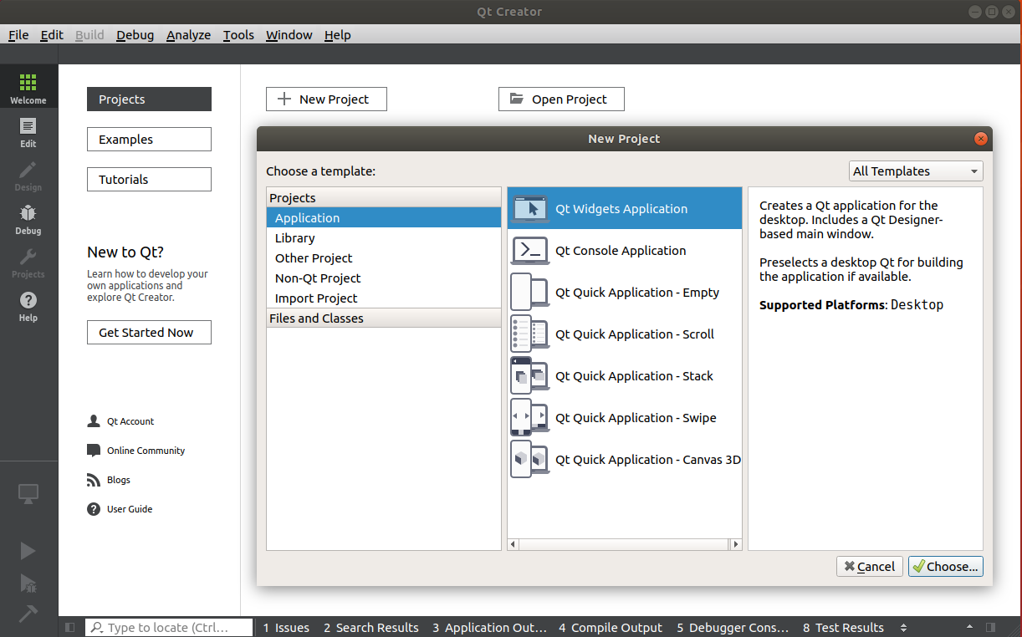
Qt Project Create

Slide 123
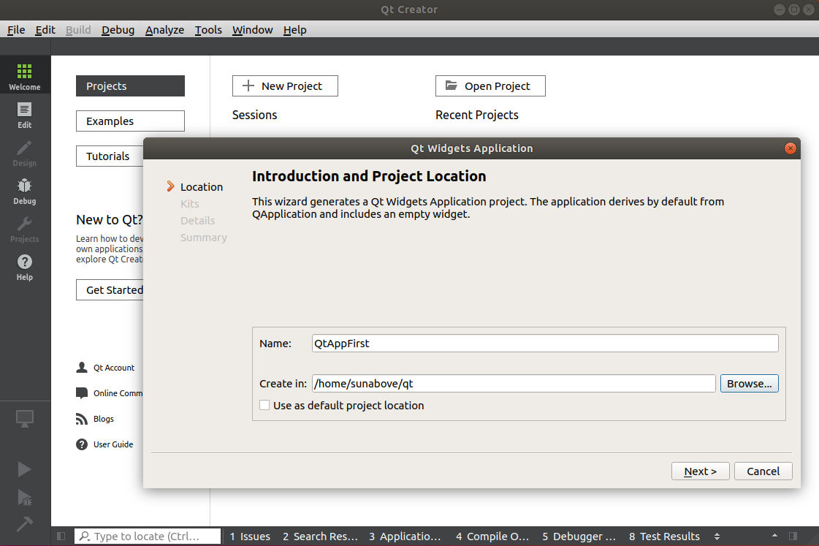
프로젝트 폴더 설정
사용자 홈디렉토리에 qt 폴더 생성

Slide 124
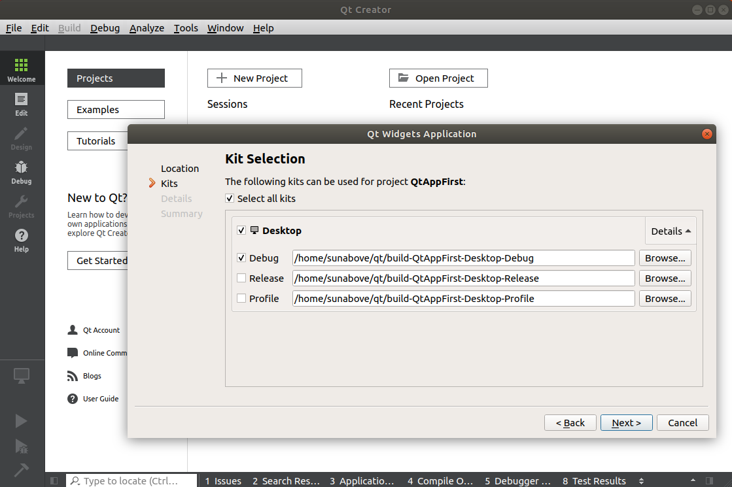
Kit Selection

Slide 125
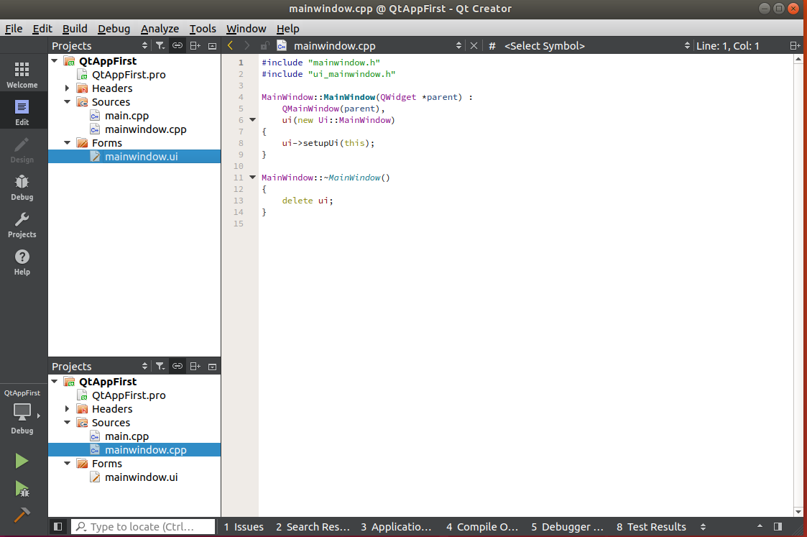
UI 디자인
Forms > mainwindow.ui 파일 더블 클릭

Slide 126
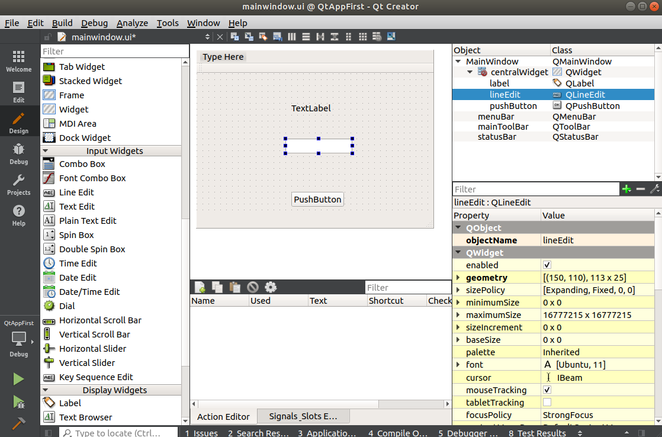
UI 디자인
Widget 추가
PushButton
Label
LineEdit

Slide 127
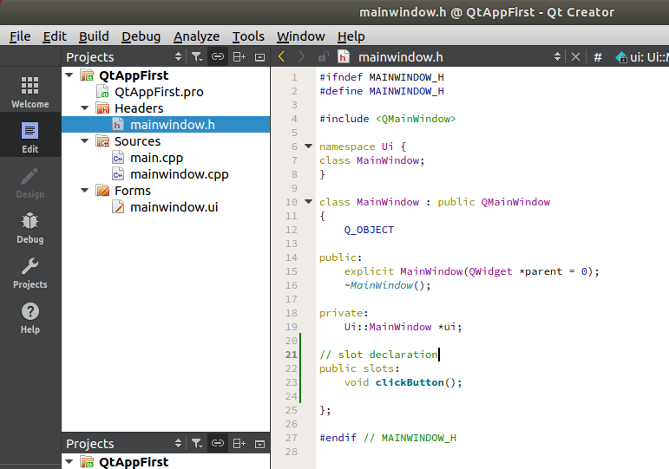
Widget Slot 선언
Headers -> mainwindow.h
clickButton() slot 추가

Slide 128
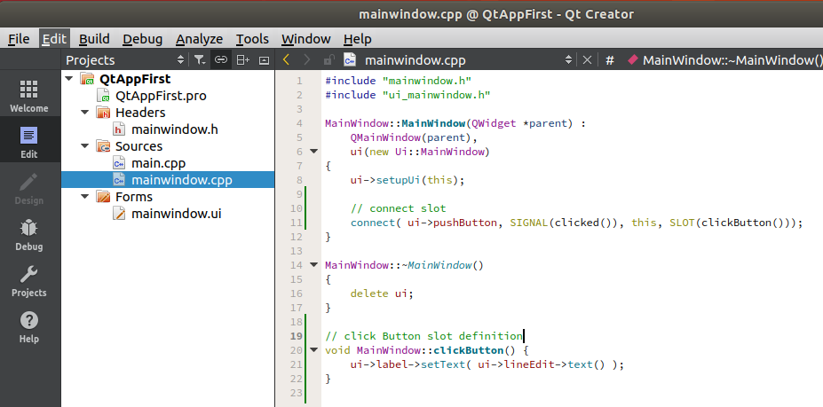
Widget Slot 정의 및 연결
Sources -> mainwindow.cpp
clickButton() 함수 추가
connect( …. ) 슬롯 연결

Slide 129
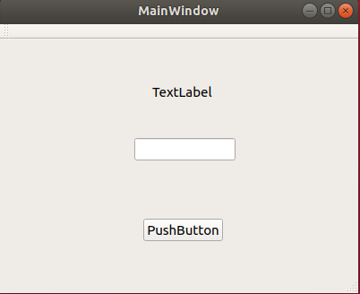
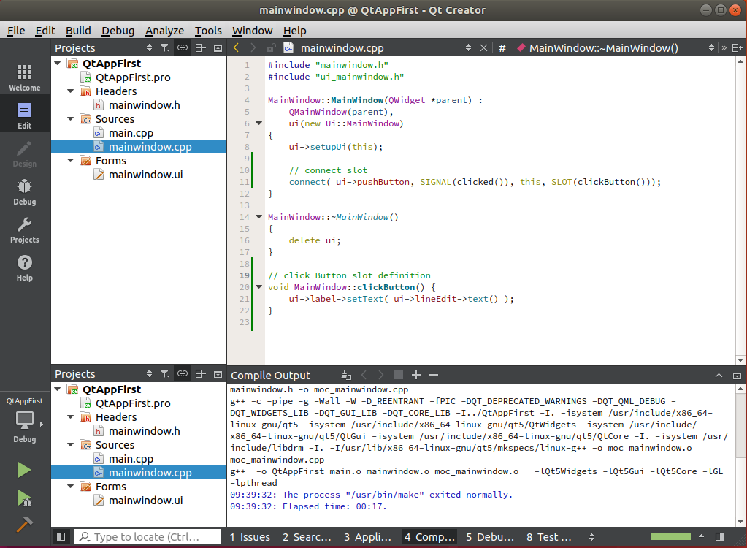
어플리케이션 실행
빌드 버튼 클릭
실행 버튼 클릭
(2) 실행
(1) 빌드

Slide 130
UI 구성요소 용어 비교
 | UI Set | Component | Event | Listener
Qt | ui | Widget | Signal | Slot
Visual Studio |  | Control/Form | Event | EventHandler
Java |  | Component | Event | Listener
Android | Activity | Component | Event | Listener
Swift | Activity

Slide 131
Database
SQLite Programming

Slide 132
SQLite Database programming 개요
SQLite 소개
DBMS/SQL 개념
SQL 실습
SQLite C Api
Sqlite Browser build

Slide 133
SQLite 개요
홈페이지
http://www.sqlite.org/
SQLite
가장 인기 높은 임베디드 데이터베이스
파일 포맷으로 사용
윈도우/유닉스/안드로이드/아이폰 지원
프로그램 크기가 작다.
메모리 데이터 베이스 지원

Slide 134
SQLite 컴파일 방법
소스 다운로드
https://www.sqlite.org/index.html
https://www.sqlite.org/download.html
https://www.sqlite.org/2018/sqlite-src-3250200.zip
컴파일 방법
https://www.sqlite.org/howtocompile.html
Unix 환경
gcc -o sqlite shell.c sqlite3.c -lpthread –ldl
MSVC 환경
cl sqlite.exe shell.c sqlite3.c -Fesqlite3.exe

Slide 135
SQL 실습
참고 자료
https://www.tutorialspoint.com/sqlite/

Slide 136
Database를 사용하는 목적
모든 데이터 관리를 DB에서 한다.
입력/조회/수정/삭제
모든 데이터의 기준은 DB 이다.
대용량 데이터를 처리한다.

Slide 137
SQL
정규화
테이블 분할 -> 중복 데이터 최소화
빠른 조회
DML은 조합가능하다.
SELECT + SELECT
INSERT/UPDATE/DELTE + SELECT
CREATE + SELECT
PRIMARY KEY
레코드 아이디
FOREIGN KEY
다른 테이블의 데이터를 참조한다.
JOIN
테이블 합병
TRIGGER
레코드 변경시에 함수 호출
INDEX
빠른 조회

Slide 138
SQL 정리
테이블
물리적 테이블 : CREATE TABLE
논리적 테이블 :
SELECT * FROM
CREATE VIEW
JOIN : 테이블을 합치는 것
CROSS JOIN
Cartesian Product
INNER JOIN
조건에 부합하는 행만 출력
OUTER JOIN
기준 테이블은 모두 출력
SELF JOIN
같은 테이블을 합치는 것

Slide 139
SQLite Programming
SQLite Database
SQL
C API
C API
Database
SQL
결과

Slide 140
SQLite C Api
Api 문서
https://www.sqlite.org/cintro.html
예제
http://zetcode.com/db/sqlitec/

Slide 141
SQLite C API
SQLite version
sqlite3_libversion()
Inserting data
sqlite3_exec()
The last inserted row id
sqlite3_last_insert_rowid()
Retrieving data
int callback(void *NotUsed, int argc, char **argv, char **azColName)
rc = sqlite3_exec(db, sql, callback, 0, &err_msg);
Parameterized queries
rc = sqlite3_prepare_v2(db, sql, -1, &res, 0);
sqlite3_bind_int(res, 1, 3);
int step = sqlite3_step(res);
Inserting BLOB
sqlite3_bind_blob(pStmt, 1, data, size, SQLITE_STATIC);
Reading BLOB
bytes = sqlite3_column_bytes(pStmt, 0);
Metadata
char *sql = "PRAGMA table_info(Cars)";
Transactions
char *sql = "BEGIN TRANSACTION;" "INSERT INTO Friends(Name) VALUES ('Rebecca');" "COMMIT;";

Slide 142
SQLite browser
SQLite browser
QT 기반 sqlite 툴
홈페이지 https://sqlitebrowser.org/
소스 : https://github.com/sqlitebrowser/sqlitebrowser
컴파일 방법
https://github.com/sqlitebrowser/sqlitebrowser/wiki/Compiling-on-Ubuntu-16.04-with-Qt-Creator
설치 방법
sudo apt install sqlitebrowser
실행방법
sqlitebrowser

Slide 143
SQLite browser Build
git clone https://github.com/sqlitebrowser/sqlitebrowser.git
QtCreator Open Project
sudo apt install libsqlite3-dev
sqlite3.h sqlite3.c 파일을 sqlitebrowser/src 폴더에 복사
Build -> Build All
Run

Slide 144
File I/O
buffered I/O programming

Slide 145
File I/O
Shape header file I/O
Logging
Shape main file I/O

Slide 146
ESRI Shape File
ESRI Shapefile Technical Description
https://www.esri.com/library/whitepapers/pdfs/shapefile.pdf
Why Shape files?
A shapefile stores nontopological geometry and attribute information for the spatial features in a data set.
Shapefiles can support point, line, and area features
An ESRI shapefile consists of a main file, an index file, and a dBASE table.
Main file: each record describes a shape with a list of its vertices.
In the index file: each record contains the offset of the corresponding main file record from the beginning of the main file.
The dBASE table contains feature attributes with one record per feature.
Example
Main file : counties.shp
Index file : counties.shx
dBase file : counties.dbf

Slide 147
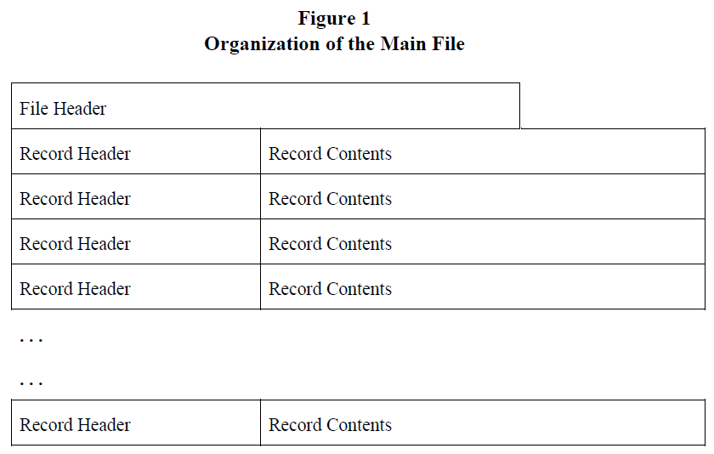
Organization of the Main File
The main file (.shp) contains
a fixed-length file header followed by
variable-length records.

Slide 148
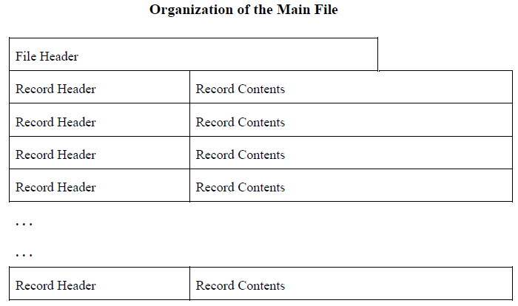
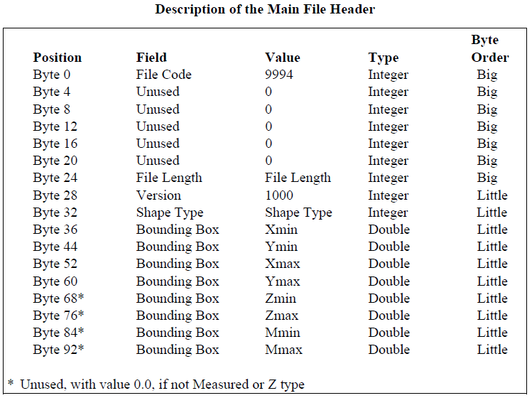
The Main File Header
The main file header is 100 bytes long. Table 1 shows the fields in the file header with their byte position, value, type, and byte order. In the table, position is with respect to the start of the file.

Slide 149
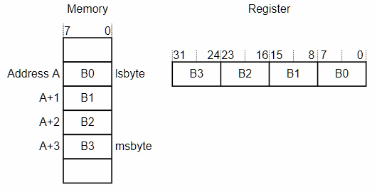
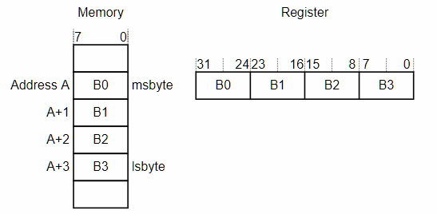
ENDIAN
Little Endian | Big Endian
작은 값이 메모리에 먼저 위치한다. the least significant byte at the lowest-numbered byte the most significant byte at the highest-numbered byte. X86/X64 아키텍쳐 | 큰 값이 메모리에 먼저 위치한다. the most significant byte at the lowest-numbered byte the least significant byte at the highest-numbered byte. Network IO / ARM 아키텍쳐
Little Endian
Big Endian

Slide 150
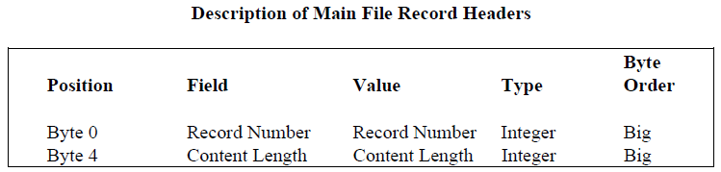
Record Headers
The header for each record stores the record number and content length for the record.
Record headers have a fixed length of 8 bytes.

Slide 151
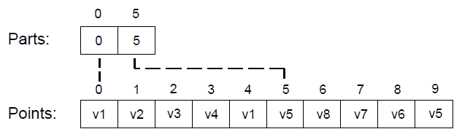
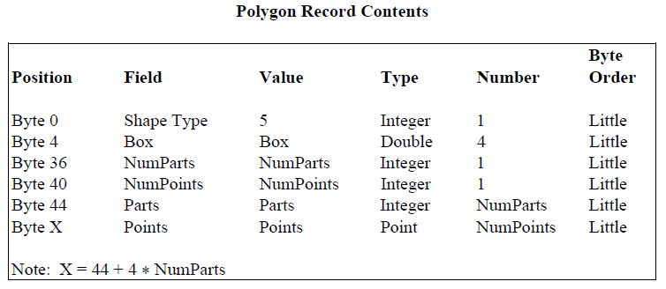
Polygon
Polygon {
Double[4] Box // Bounding Box
Integer NumParts // Number of Parts
Integer NumPoints // Total Number of Points
Integer[NumParts] Parts // Index to First Point in Part
Point[NumPoints] Points // Points for All Parts
}

Slide 152
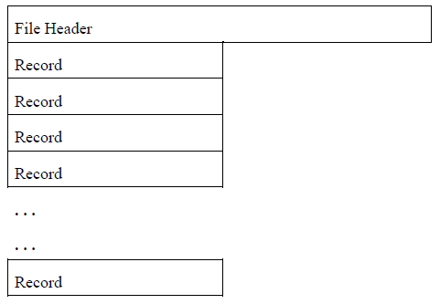
Organization of the Index File
The index file (.shx) contains
a 100-byte header followed by
8-byte, fixed-length records.
The index file header is identical to the main file header.

Slide 153
Index Records
The I’th record in the index file stores the offset and content length for the I’th record in the main file.
Position | Field | Value | Type | Byte Order
Byte 0 | Offset | Offset | Integer | Big
Byte 4 | Content Length | Content Length | Integer | Big

Slide 154
ShapeViewer Build
shapelib 빌드
URL : http://shapelib.maptools.org/
API : http://shapelib.maptools.org/shp_api.html
git clone https://github.com/OpendTect/shapelib
cd shapelib
sudo apt install cmake
cmake .
make

Slide 155
실습 프로그램
shape main file의 헤더 정보를 출력하는 프로그램을 작성하세요.

Slide 156
Logging
A log file is a file that records either events that occur in an operating system or other software runs, or messages between different users of a communication software.
Logging is the act of keeping a log.
In the simplest case, messages are written to a single log file.

Slide 157
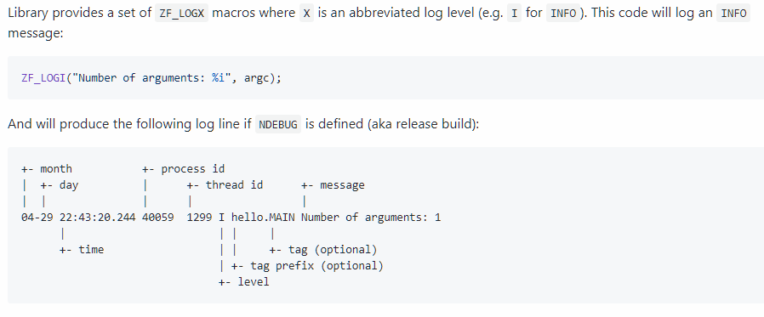
Logging
zf_log
URL : https://github.com/wonder-mice/zf_log
소스 설치 방법
git clone https://github.com/wonder-mice/zf_log
cd zf_log
cmake .
make

Slide 158
Example Code
#include <signal.h>
#include <unistd.h>
#define ZF_LOG_LEVEL ZF_LOG_INFO
#include <zf_log.h>
int main(int argc, char *argv[]) {
ZF_LOGV("Argument : %i", kill(getpid(), SIGKILL));
ZF_LOGI("So you will see that INFO message");
return 0;
}

Slide 159
Custom Callback For stdout
#include "zf_log.h"
static void custom_output_callback(const zf_log_message *msg, void *arg) {
FILE * out = stdout ;
fprintf( out, msg->buf, arg );
fprintf( out, "\n" ); fflush( out );
}
int main(int argc, char *argv[]) {
zf_log_set_output_v(ZF_LOG_PUT_STD, 0, custom_output_callback);
zf_log_set_output_level(ZF_LOG_DEBUG);
ZF_LOGI("A: %i", argc);
ZF_LOGW("B: %s", "");
ZF_LOGD("C");
return 0;
}

Slide 160
Custom Callback For QT
#include "zf_log.h"
static void custom_output_callback(const zf_log_message *msg, void *arg) {
qDebug( msg->buf, arg );
}
int main(int argc, char *argv[]) {
zf_log_set_output_v(ZF_LOG_PUT_STD, 0, custom_output_callback);
zf_log_set_output_level(ZF_LOG_DEBUG);
ZF_LOGI("A: %i", argc);
ZF_LOGW("B: %s", "");
ZF_LOGD("C");
return 0;
}

Slide 161
Qt Grphics
URL : http://doc.qt.io/qt-5/topics-graphics.html
Paint System - the QPainter classes and architecture.
Coordinate System - QPainter's coordinate system works.
Drawing and Filling - QPainter performs filling and outlining of vector shapes.

Slide 162
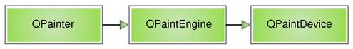
Qt Paint System
QPainter is used to perform drawing operations
QPaintDevice is an abstraction of a two-dimensional space that can be painted on using a QPainter, and QPaintEngine provides the interface that the painter uses to draw onto different types of devices.
The QPaintEngine class is used internally by QPainter and QPaintDevice, and is hidden from application programmers unless they create their own device type.

Slide 163
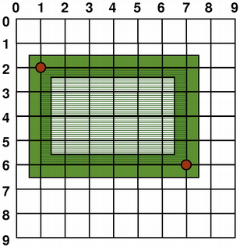
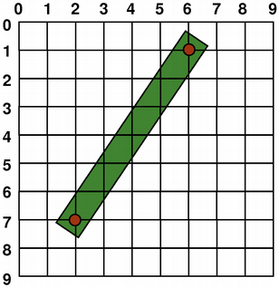
Qt Coordinate System
The coordinate system is controlled by the QPainter class.
Together with the QPaintDevice and QPaintEngine classes, QPainter form the basis of Qt's painting system, Arthur.
QPainter is used to perform drawing operations, QPaintDevice is an abstraction of a two-dimensional space that can be painted on using a QPainter, and QPaintEngine provides the interface that the painter uses to draw onto different types of devices.

Slide 164

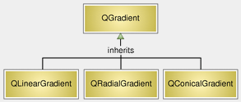
Qt Drawing and Filling
QPainterPath is an object composed of lines and curves. For example, a rectangle is composed by lines and an ellipse is composed by curves.
The main advantage of painter paths over normal drawing operations is that complex shapes only need to be created once; then they can be drawn many times using only calls to the QPainter::drawPath() function.

Slide 165
강의 내용
순서 | 강의 내용
1 | File I/O 프로그래밍
2 | 리눅스 데이터베이스 프로그래밍
3 | 통신 프로토콜 프로그래밍
4 | 통신 Garbage Data Filtering
5 | 리눅스 SOAP 통신 프로그래밍

Slide 166
통신 프로토콜
Network

Slide 167
통신 프로토콜
TCP/IP 환경에서 프로토콜 정의 및 송수신
안정적인 데이터 송수신
오류 확인/오류 전송
가비지 데이터 필터링

Slide 168
시스템 통신 시나리오
서버
(1) 환영메시지 (0x04)
(2) 단문메시지(0x22)
(3) 파일전송 (0x24)
(4) 종료 메시지(0x26)

Slide 169
통신 프레임 구조
구분 |  | 내용 | 타입 | 길이 | 비고
Header | OP Code | 운영코드 | uchar | 1 | 세부 운영코드 참조
 | Sequence No | 송신정보에 대한 일련번호 | uint | 4 | 순차적 증가
 | Flow Control | 메시지 응답 여부 | uchar | 1 | 0x00: 응답없음 (NACK) 0x01: 응답요구 (ACK)
 | C/L | Continuous / Last | uchar | 1 | 0x11: 전송 시작 0x01: 전송 계속 0x00: 전송 종료
 | 시간정보 | 전송 시각 [년,월,일,시,분,초] | uint | 4 | DATE
 | 단말기 ID | 단말기 고유번호 | uint | 4
 | Data Length | Body의 데이터 크기 | uint | 4 | n
Body | Data | 운영 코드에 따른 데이터 | OpBody | n

Slide 170
Op Code 정의
구분 | 항목 | OPCode | 주기 | 내용 | 비고
서버 ← 단말 | 시스템 정보 | 0x04 | 즉시 | 시스템 정보 전송
서버 ←→ 단말 | 단문 메시지 | 0x22 | 즉시 | 단문 메시지 전송
서버 ←→ 단말 | 파일 전송 | 0x24 | 즉시 | 파일 이름, 파일 데이터 전송 | 과제
서버 ← 단말 | 종료 메시지 | 0x26 | 즉시 | 종료 메시지 전송 | 실습
서버 ←→ 단말 | ACK | 0xA0 | 즉시 | 정상적인 수신명령에 대한 성공 확인 | 필터링
 | NACK | 0xA1 | 즉시 | 잘못된 수신명령에 대한 오류확인 | 필터링

Slide 171
Op Code 정의 예
구분 | 항목 | OPCode | 주기 | 내용
센터<->버스 | ACK | 0xA0 | 즉시 | 정상적인 수신명령에 대한 성공 확인
 | NACK | 0xA1 | 즉시 | 잘못된 수신명령에 대한 오류 확인
센터 <- 버스 | 버스정보 수집 | 0x04 | 30초 | 버스ID, 위치, 속도, 시각, 장치상태 등 단말기 수집정보를 근간으로한 데이터 전송
 | Config정보 수집 | 0x05 | 주기 | 차량단말기 Version 및 운영파라메터 정보
 | 이벤트정보 수집 | 0x06 | 즉시 | 기/종점 출발, 정류장 도착/출발, 교차로 통과등 단말기에서 발생한 이벤트 및 운전자 조작 또는 차량단말기에 의한 돌발정보 전송
 | 운행위반정보 수집 | 0x08 | 즉시 | 버스 운행 위반(급출발, 급제동, 과속, 개문주행 등) 발생시 즉시 전송
 | 통신설정값 요청 | 0x09 | 즉시 | 무선통신서버 #1, #2의 IP, Port 값 요청
 | 이벤트 이력정보 전송 | 0x61 | 요청시 | 이벤트 이력정보 전송요청 수신신 저장된 이력정보를 요청 개수만큼 전송
센터->버스 | 배차정보 제공 | 0x20 | 즉시 | 앞/뒤차 배차정보, 소통정보, 운행예상시간을 전송하며 센터에서 차량단말기로는 제공 방식에 따라 전송
 | 차량단말기 단문 메시지 전송 | 0x22 | 즉시 | 운영자에 의해 입력된 단문 메시지 전송
 | 통신설정값 전송 | 0x25 | 즉시 | 무선통신서버 #1, #2의 IP, Port 값 전송
 | Config정보 전송 | 0x40 | 즉시 | 단말기 운영 파라메터 전송
 | Config정보 전송 요청 | 0x41 | 즉시 | 단말기 운영 파라메터 정보 전송 요청

Slide 172
OpCodeSysInfo : 시스템 정보 (0x04)
시스템 정보
항목 | 크기 | 타입 | 내용 | 비고
단말 아이디 | 4 | unsigned int | 단말 아이디 부여
메시지 길이 | 2 | unsigned short | 메시지 길이
시스템 메시지 | n | ASCII | 시스템 메지시 | 환영 메시지
합 계 | 8 + n

Slide 173
OpCodeAck : ACK (0xA0)
패킷이 정상적으로 수신되었음을 전송한다.
항목 | 크기 | 단위 | 내용 | 비고
수신 Sequence No | 4 | unsigned int | 수신정보에 대한 일련번호
수신OPcode | 1 | unsigned char | 수신정보에 대한 운영코드
합계 | 5

Slide 174
OpCodeNack : NACK (0xA1)
패킷이 비정상적으로 수신되었음을 전송한다.
항목 | 크기 | 단위 | 내용 | 비고
수신 Sequence No | 4 | unsigned int | 수신정보에 대한 일련번호
수신 OPcode | 1 | unsigned char | 수신정보에 대한 운영코드
NACK Code | 1 | unsigned char | 수신오류에 따른 코드
합계 | 6

Slide 175
OpCodeMsg : 단문 메시지 (0x22)
단문 메시지를 전송하고 화면에 표시한다.
항목 | 크기 | 타입 | 내용 | 비고
Msg Length | 2 | unsigned short | 메시지 데이터 Size
메시지 데이터 | n | ASCII | 메시지 데이터 정보
합 계 | 2 + n

Slide 176
OpCodeFile : 파일 데이터 (0x24)
파일 데이터를 전송한다.
항목 | 크기 | 타입 | 내용 | 비고
데이터 순차번호 | 2 | unsigned short | 데이터 순차 번호
파일 사이즈 | 8 | unsigned long | 파일 사이즈
데이터 사이즈 | 2 | unsigned short | 데이터 사이즈 | n
데이터 | n | unsigned char | 데이터
합 계 | 12 + n

Slide 177
OpCodeExit : 종료 메시지 (0x26)
종료 메시지를 전송한다.
항목 | 크기 | 타입 | 내용 | 비고
종료 구분 | 1 | unsigned char | 종료 구분 | 0 : 정상 종료 1 : 비정상 종료
합 계 | 1

Slide 178
통신 프로토콜 실습
종료 메시지 송신 기능 구현

Slide 179
Garbage Data Filtering
Network

Slide 180
Garbage Data Filtering
안정적인 데이터 송수신
Garbage Data Filtering
오류 확인
오류 전송

Slide 181
Garbage Data Filtering
Data Frame
Header |  |  |  | Body
Data Frame
Header |  |  |  | Body
Data Frame
Header |  |  |  | Body

Slide 182
Garbage Data Filtering 순서도
시작
SOH/Header Reading
SOH/Header Validation
Send NACK
Y/N
Body Reading
Send ACK
종료

Slide 183
데이터 필터링 통신 프레임 구조
구분 |  | 내용 | 검증 | 타입 | 길이 | 비고
Header | OP Code | 운영코드 | O | uchar | 1 | 세부 운영코드 참조
 | Flow Control | 메시지 응답 여부 | O | uchar | 1 | 0x00: 응답없음 (NACK) 0x01: 응답요구 (ACK)
 | C/L | Continuous / Last | O | uchar | 1 | 0x11: 전송 시작 0x01: 전송 계속 0x00: 전송 종료
 | 시간정보 | 전송 시각 | O | uint | 4 | [년,월,일,시,분,초]
 | Data Length | Body 데이터 크기 | X | ushort | 2 | n
 | 단말기 ID | 단말기 고유번호 | X | uint | 4
 | Sequence No | 송신정보에 대한 일련번호 | X | uint | 4 | 순차적 증가
Body | Data | 운영 코드에 따른 데이터 | X | OpBody | n

Slide 184
통신 프로토콜 실습
전송시각 데이터 필터링
ACK/NACK 기능 구현
파일 송수신 기능 구현

Slide 185
통신절차
Flow Control : 응답 요구 없음
응답요구가 없는 경우에는 데이터 송신 후 통신절차가 끝남.
Flow Control : 응답요구 필요
데이터의 용량이 클 경우 C/L값을 0x01로 설정하여 여러 패킷으로 나누어 보냄
수신한 메시지를 검사하여 응답(ACK/NACK)을 전송
NAK응답일 경우 송신측은 정해진 반복회수 만큼 재전송을 함
전송할 데이터가 계속 이어질 경우 ① ~ ②를 반복 수행함
마지막 데이터를 전송할 때 C/L값을 0x00으로 설정하여 전송함
수신한 메시지를 검사하여 응답(ACK/NACK)을 보냄

Slide 186
ACK(응답요구 없음) 통신 절차
데이터 송신

Slide 187
ACK(응답 요구) 통신 절차
(1) 데이터 송신
(2) NACK
(3) 데이터 재송신
(2) ACK

Slide 188
SOAP Programming
Network

Slide 189

XML
XML stands for eXtensible Markup Language.
XML was designed to store and transport data.
XML was designed to be both human- and machine-readable.
<note> <to>Tove</to> <from>Jani</from> <heading>Reminder</heading> <body>Don't forget me!</body> </note>

Slide 190
SOAP (Simple Object Access Protocol)
SOAP is a messaging protocol specification for exchanging structured information in the implementation of web services in computer networks.
Its purpose is to induce extensibility, neutrality and independence.
It uses XML Information Set for its message format, and relies on application layer protocols, most often Hypertext Transfer Protocol (HTTP) or Simple Mail Transfer Protocol (SMTP), for message negotiation and transmission.
SOAP allows processes running on disparate operating systems (such as Windows and Linux) to communicate using Extensible Markup Language (XML).
Since Web protocols like HTTP are installed and running on all operating systems, SOAP allows clients to invoke web services and receive responses independent of language and platforms.

Slide 191
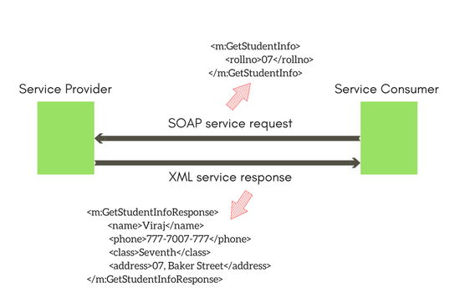
SOAP History
SOAP was designed as an object-access protocol in 1998.
Version 1.2 of the specification became a W3C recommendation on 2003.
SOAP became the underlying layer of a more complex set of web services.

Slide 192
soap client
sudo apt intall gsoap
a working C++ client that invokes the calculator service:
wsdl2h -o calc.h http://www.genivia.com/calc.wsdl
Next, you run the soapcpp2 CLI to generate the data binding implementation that "glues" your code to the service operations:
soapcpp2 -j -CL -I/usr/share/gsoap/import calc.h
Main program calcclient.cpp to invoke the calculator service:
g++ -o calcclient calcclient.cpp soapC.cpp soapcalcProxy.cpp -lgsoap++
#include "calc.nsmap"
#include "soapcalcProxy.h"
#includes "soapH.h" and "soapStub.h"
int main() {
calcProxy calc;
double sum;
if (calc.add(1.23, 4.56, sum) == SOAP_OK)
std::cout << "Sum = " << sum << std::endl;
else calc.soap_stream_fault(std::cerr);
calc.destroy();
}

Slide 193
soap server
wsdl2h -o calc.h http://www.genivia.com/calc.wsdl
soapcpp2 -j -SL -I/usr/share/gsoap/import calc.h
g++ -o calcserver calcserver.cpp soapC.cpp soapcalcService.cpp -lgsoap++
./calcserver < calc.add.req.xml
#include "calc.nsmap"
#include "soapcalcService.h"
int main() {
calcService calc(SOAP_XML_INDENT);
if (calc.serve() != SOAP_OK)
calc.soap_stream_fault(std::cerr);
calc.destroy();
}
int calcService::add(double a, double b, double &result) {
result = a + b;
return SOAP_OK;
}

Slide 194
끝.

